Slide 1

CanSat 2015 Critical Design Review (CDR)
Team 4996
Team Phoenix

Slide 2
Presentation Outline
Introduction – Ruben Perez
System Overview – Ruben Perez
Sensor Subsystem – Maria F. Caceres
Descent Control Design– Patrick Guillaume
Mechanical Subsystem Design – Majlinda Malellari
Communications & Data Handling Subsystem Design – Demetrios Doumas
Electrical Power Subsystem – Joel Annenberg
Flight Software Design – Demetrios Doumas
Ground Control System Design – Demetrios Doumas
CanSat Integration and Testing – Sakif Chowdhury
Mission Operations & Analysis – Ruben Perez
Management – Ruben Perez
Conclusions – Ruben Perez
Presenter: Ruben Perez

Slide 3
Introduction
Ruben Perez

Slide 4
Team Organization
CanSat Team Mentor:
Caitlin Marsh
Mechanical Systems:
Majlinda M.
Faculty Advisor: Y. Andreopoulos
Sensor Systems: Maria C.
Communication & Data Handling:
Demetrios D.
CanSat Integration & Testing:
Sakif C .
Management: Ruben P.
.
2015 CanSat Team:
PHOENIX
Team Leaders:
Ruben P.
Mission Operations & Analysis: Ruben P.
Electrical Power System:
Joel A.
Descent Control:
Patrick G.
Presenter: Ruben Perez

Slide 5
Acronyms
A– Analysis
CDR – Critical Design Review
CONOP – Concept of Operations
D – Demonstration
DCS – Descent Control System
FSW – Flight Software
GCS – Ground Control Station
HW – Hardware
HWR – Hardware Review
I – Inspection
LCO – Launch Control Officer
PDR – Preliminary Design Review
PFB – Pre Flight Briefing
PFR – Post Flight Review
RSO – Range Safety Officer
SOE – Sequence of Events
T – Test
TBD – To Be Determined
TBR – To Be Resolved
VM – Verification method
Presenter: Ruben Perez

Slide 6
Systems Overview
Ruben Perez

Slide 7
Mission Summary
BASE MISSION SUMMARY
Mass: 600 grams +/- 10
Dimensions: 125mm x 310mm cylindrical
Apogee Deployment at 600m
Payload separation from container at 500m
Passive helicopter/auto-gyro recovery
Stabilize and descend properly at a minimum altitude of 300m
Payload Descent rate must be <10m/s and >4m/s
Payload lands a large hen egg intact
SELECTABLE OBJECTIVE REQUIREMENTS
Three-axis accelerometer to measure the stability and angle of descent of the payload during descent
Easier to implement with our CanSat configuration
Presenter: Ruben Perez

Slide 8
Summary of Changes Since PDR
Electrical System Changes
Using LSM303 (accelerometer and magnetometer) instead of ADXL345
Chrono Dot
Mechanical System Changes
No changes
Presenter: Ruben Perez

Slide 9
System Requirement
ID | Req. No | REQUIREMENT
MR-01 | 1 | Mass: 600 ⁺/- 10 grams (CanSat + container + all descent control devices)
MR-02 | 3 | Dimensions: Container must fit in cylindrical payload section of 125mm x 310mm
MR-03 | 4 | Container must use passive descent control system
MR-04 | 5 | Container must not have sharp edges
MR-05 | 6 | Container must be a florescent color, pink, or orange
MR-06 | 9 | CanSat will deploy from rocket payload section
MR-07 | 10 | CanSat will deploy from the rocket payload section
MR-08 | 11 | Use Helicopter recovery system
MR-09 | 12 | All descent control device attachments must survive 50 Gs of shock
MR-10 | 14 | All electronics must be enclosed and shielded from the environment except for sensor
MR-11 | 15 | All structures must be built to survive 15 Gs acceleration
Presenter: Ruben Perez

Slide 10
System Requirement Cont’d
ID | Req. No | REQUIREMENT
MR-12 | 16 | All structures shall be built to survive 30 Gs of shock.
MR-13 | 18 | All mechanisms must be capable to maintain their configurations under all forces
MR-14 | 19 | Mechanisms shall not use pyrotechnics or chemical
MR-15 | 21 | During descent, the Science Vehicle shall collect and telemeter air pressure, outside and inside air temperature, flight software state, battery voltage, and bonus objective data.
MR-16 | 22 | CanSat will transmit telemetry data every one second
MR-17 | 24 | 900 MHz XBEE Pro radio will be used
MR-18 | 25 | XBEE NETID/PANID set to the team number
MR-19 | 26 | XBEE radio shall not use broadcast mode
MR-20 | 27-28 | The Science Vehicle shall have a video camera installed and recording the complete descent from deployment and landing and include time stamp on the video.
MR-21 | 29 | Science Vehicle descent needs to <10m/s, but >4m/s
Presenter: Ruben Perez

Slide 11
System Requirement Cont’d
ID | Req. No | REQUIREMENT
MR-22 | 30 | During descent, the video camera must not rotate. The image of the ground shall maintain one orientation with no more than +/- 90 degree rotation.
MR-23 | 31 | Budget: $1000
MR-24 | 33-34 | Telemetry must be display in real time and engineering unit during descent
MR-25 | 35 | Teams shall plot data in real time during flight on the ground station computer.
MR-26 | 36-37 | The ground station shall include one laptop computer, xbee radio and ah and held or table top antenna. Ground station shall be portable.
MR-27 | 38 | The Science Vehicle shall hold one large raw hen’s egg which shall survive launch, deployment and landing.
MR-28 | 40 | The CanSat flight software shall maintain and telemeter a variable indicating its operating state.
MR-28 | 42 | Include an easily accessible power switch which does not require removal from the container for access.
Presenter: Ruben Perez

Slide 12

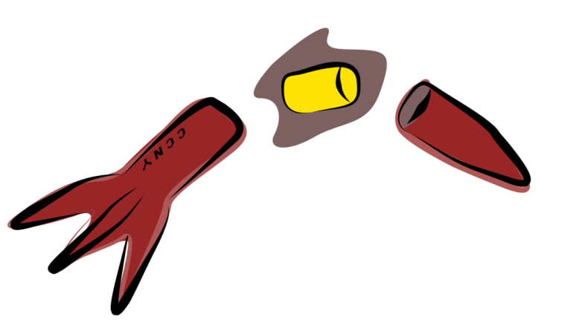
System Concept of Operations
Pre launch
Preflight briefing
Integrate CanSat into Payload
Rocket Launched
CanSat will rest in payload envelope
Rocket is launched
CanSat Deployment
600m altitude the CanSat is deployed
Data will be received for the following
The mechanical & electrical components will be placed into the CanSat
Receive telemetry
altitude,
pressure
temperature data.
Presenter: Ruben Perez

Slide 13
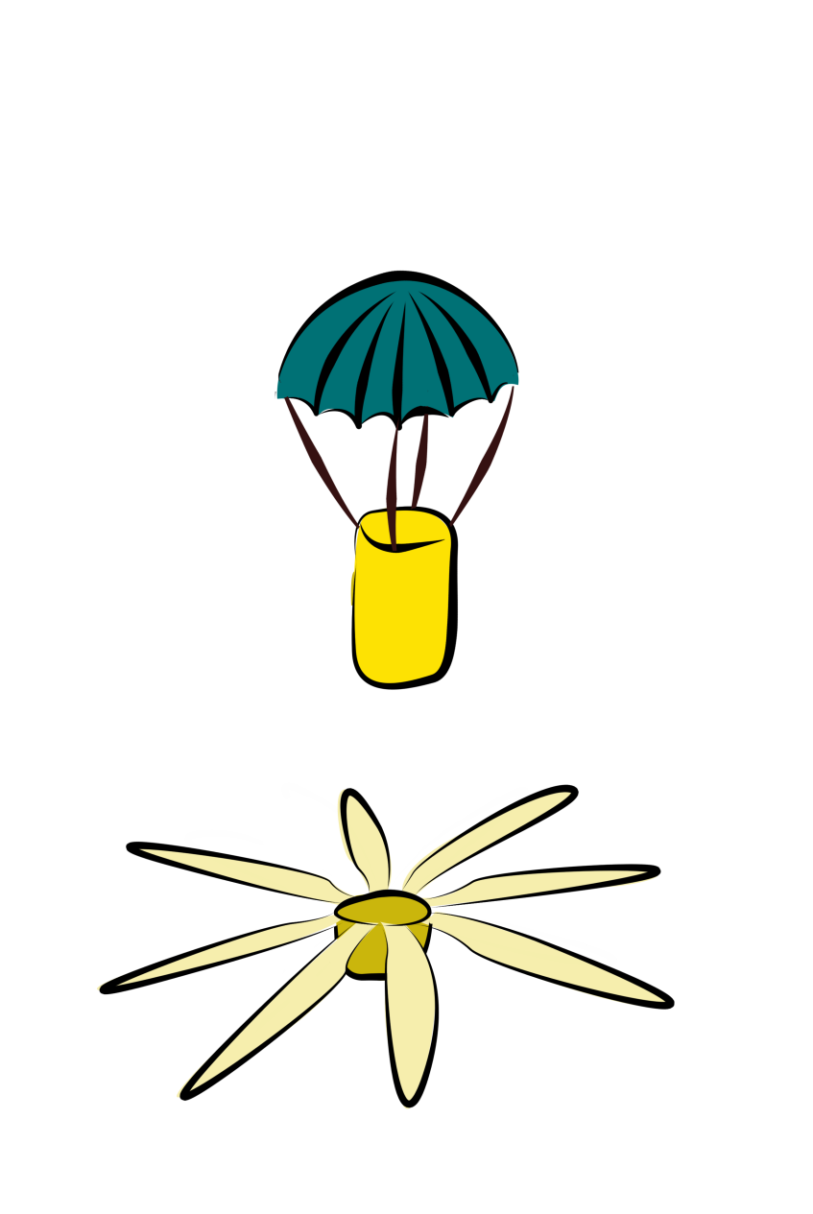
System Concept of Operations Cont’d
PAYLOAD SEPERATES FROM CONTAINER
At 500m altitude the payload will separate from the container
This is where the Autorotative blades are deployed
POST-FLIGHT
At this stage the payload will be at 0m altitude.
The egg will be checked to determine if it survived.
The payload will be located
The CanSat should stabilize at a minimum of 300m.
Descent rate must be <10m/s and >4m/s
Presenter: Ruben Perez

Slide 14

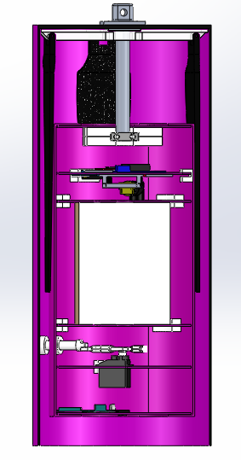
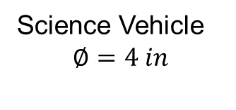
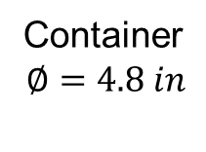
Physical Layout Full Assembly
Container
$$∅=4.8 in$$
11.5 in
Science Vehicle
$$∅=4 in$$
8.0 in
Release Mechanism
Presenter: Ruben Perez

Slide 15
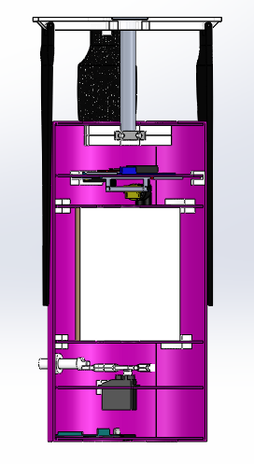
Physical Layout Science Payload
4.7 in
Descent System
2.3 in
PCB
0.72 in
Egg Container
3.34 in
8.0 in
Release Mechanism
1.08 in
1.22 in
Camera
4.0 in
Presenter: Ruben Perez

Slide 16
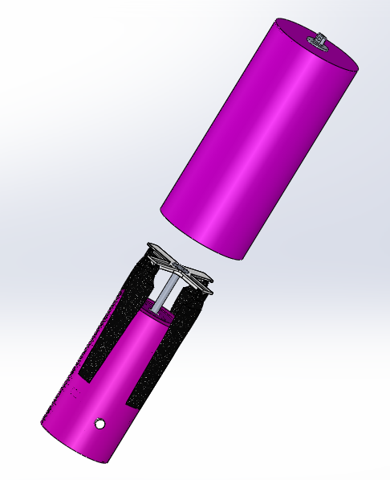
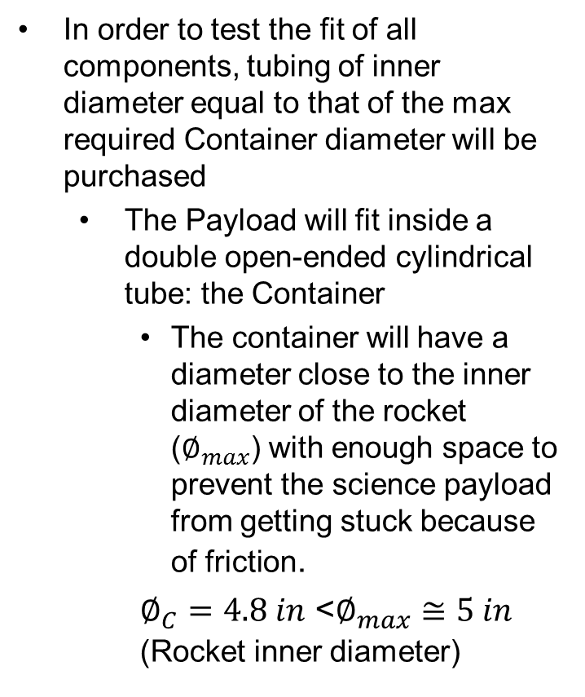
Launch Vehicle Compatibility
In order to test the fit of all components, tubing of inner diameter equal to that of the max required Container diameter will be purchased
The Payload will fit inside a double open-ended cylindrical tube: the Container
The container will have a diameter close to the inner diameter of the rocket ($∅_{max}$) with enough space to prevent the science payload from getting stuck because of friction.
$∅_{C}=4.8 in$ <$∅_{max}≅5 in$ (Rocket inner diameter)
Presenter: Ruben Perez

Slide 17

Sensor Subsystem Design
Maria F. Caceres

Slide 18

Sensor Subsystem Overview
CanSat Sensor System
Payload Sensors
Required Sensors
Secondary Sensors
Pressure Sensor
Luminosity Sensor
Altitude Sensor
Magnetometer
3-Axis Accelerometer
Inside Temperature
ChronoDot Clock
Temperature Sensors
Outside Temperature
Presenter: Maria F. Caceres
CanSat 2015 CDR: Team 4996 (Phoenix)

Slide 19
Sensor Subsystem Overview
Sensors | Model | Description | Placement Location
Altitude Sensor | BMP180 | Provides barometric (altitude derived from barometric measurements) and inside temperature measurements | Payload
Temperature Sensor | TMP36 | Provides the outside temperature measurement. | Payload
3-Axis Accelerometer + Magnetometer Sensor | LSM303 | The 3-axis accelerometer measures stability and angle of descent (objective), while the magnetometer measures magnetic field (in our case, North). | Payload
Camera | Spycrushers Keychain Camera | This camera comes with a time stamp and will record a video during descent. | Payload
Luminosity Sensor | TSL2591 | Its precision allows for exact lux calculations that would come in handy for the flight software. | Payload
Clock | ChronoDot Clock | The Chronodot is an extremely accurate clock that would be used as our mission time recorder in case of a reset. | Payload
Presenter: Maria F. Caceres
CanSat 2015 CDR: Team 4996 (Phoenix)

Slide 20
Sensor Changes Since PDR
Change | Reason
Accelerometer (from ADXL345 to LSM303) | The LSM303 is a 2-in-1 sensor (accelerometer + magnetometer) which helps saving space. The addition of the magnetometer is for camera stability.
Addition of a clock (ChronoDot) | The clock in the Arduino would not survive in case of a reset.
Presenter: Maria F. Caceres
CanSat 2015 CDR: Team 4996 (Phoenix)

Slide 21
Sensor Subsystem Requirements
ID | Req. No | REQUIREMENT
SSR-01 | 21 | During descent, the Science Vehicle shall collect and telemeter air pressure (for altitude determination), outside and inside air temperature, flight software state, battery voltage, and bonus objective data (accelerometer data and/or rotor rate).
SSR-02 | 22 | The Science Vehicle shall transmit telemetry at a 1 Hz rate.
SSR-03 | 23 | Telemetry shall include payload mission time with one second or better resolution, which begins when the payload is powered on.
SSR-04 | 27 | The Science Vehicle shall have a video camera install and recording the complete descent from deployment to landing. The video recording can start at any time and must support up to one hour of recording.
SSR-05 | 28 | The video camera shall include a time stamp in the video. The time stamp must work from the time of deployment to the time of landing.
SSR-06 | 40 | The CanSat flight software shall maintain and telemeter a variable indicating its operating state. In the case of processor reset, the flight software shall re-initialize to the correct state either by analyzing sensor data and/or reading stored state data from non-volatile memory. The states are to be defined by each team. Example states include: PreFlightTest(0), LaunchWait(1), Ascent(2), RocketDeployment(3), Stabilization(4), Separation(5), Descent(6), and Landed(7).
Derived from Bonus |  | Use a three-axis accelerometer to measure the stability and angle of descent of the Science Vehicle during descent.
Presenter: Maria F. Caceres
CanSat 2015 CDR: Team 4996 (Phoenix)

Slide 22
Altitude Sensor Summary (Payload)
Altitude Sensor for Payload
Data processing:
Processed using:
Altitude = 44330*(1-(p/1013.25)^{1/5.255} (from datasheet)
Pressure processed using Adafruit_BMP085_Unified-master
Sensor Model Adafruit BMP180
Voltage Operation | 3V - 5V
Pressure range | 300hPa – 1100hPa
Altitude range | 9000m to - 500m
Absolute Accuracy | ±2.5hPa
Presenter: Maria F. Caceres

Slide 23
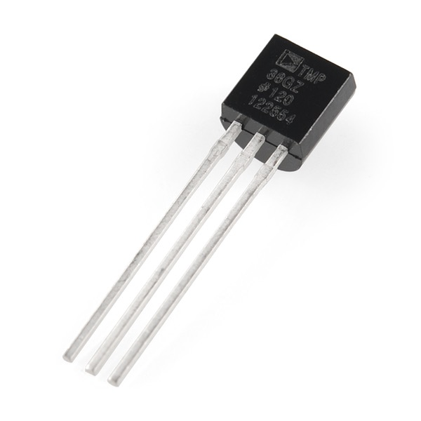
Air Temperature Sensor Summary
Temperature Sensor
Data processing:
Processed using:
Temp in °C = [(Vout in mV) - 500] / 10 (from datasheet)
Sensor Model Adafruit TMP36
Voltage Operation | 2.7V - 5.5V
Temperature range | -40ºC to 125ºC
Output Scale factor | 10 mV/ºC
Precision | 0.1 ºC
Presenter: Maria F. Caceres
CanSat 2015 CDR: Team 4996 (Phoenix)

Slide 24
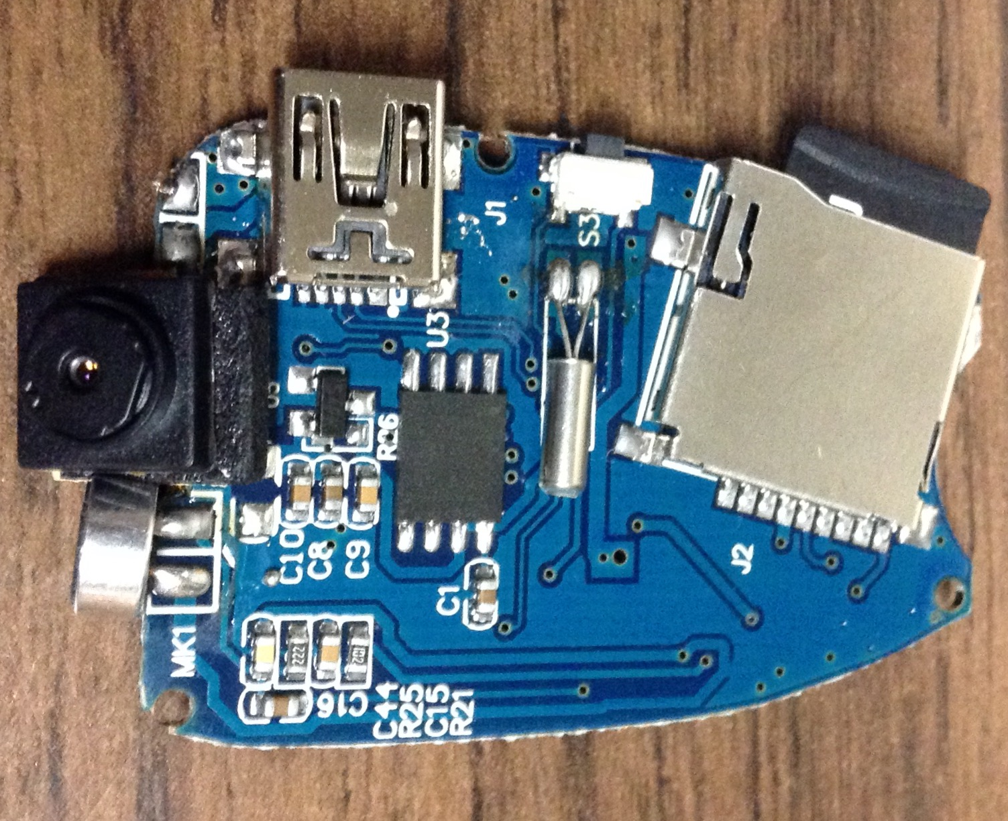
Camera Summary
Camera
Spycrushers Car Key Chain Spy Camera Keychain SpyCamera
Video Resolution | 720x480
Video Format | AVI
Video Frame Rate | 30±1 fps
Time Stamp | Processed on board, no further processing required
Recording medium | On board SD card writer
Presenter: Maria F. Caceres
CanSat 2015 CDR: Team 4996 (Phoenix)

Slide 25
3-Axis Accelerometer Sensor Summary
3-Axis Accelerometer Sensor for Container
Sensor Model Adafruit LSM303 | Adafruit ±16g Accelerometer + Magnetometer
Full scale range (Accelerometer) | ±16Gs
Accuracy (Accelerometer) | ±10%
Full scale range (Magnetometer) | ±1.3Gs to ±8.1Gs
Accuracy (Magnetometer) | ±10%
Presenter: Maria F. Caceres
CanSat 2015 CDR: Team 4996 (Phoenix)

Slide 26
Descent Control Design
Patrick Guillaume

Slide 27
Descent Control Overview
Descent control is used in both the Container and Payload components of the CANSAT:
Container: Drag by Parachute
Payload: Auto-gyro system using Carbon fiber blades
CANSAT Section | Control Scheme | Descent Required | Dependencies | Components | Configurations
Container | Parachute | N/A | -Air Flow -CANSAT mass -Parachute Area | -Kevlar string -Ripstop Nylon -Swivel | Upon separation from the rocket, the container’s parachute will deploy, allowing the CanSat to descend at a controlled rate.
Payload | Auto-gyro | 4m/s<v<10 m/s | - Air Flow - CANSAT mass - Rotor Area - Angle of attack | -Carbon-Fiber propellers -Torsion Springs -Ball bearing | Upon release from container, propellers will fold out and will start to rotate due to air flow
Presenter: Patrick Guillaume

Slide 28
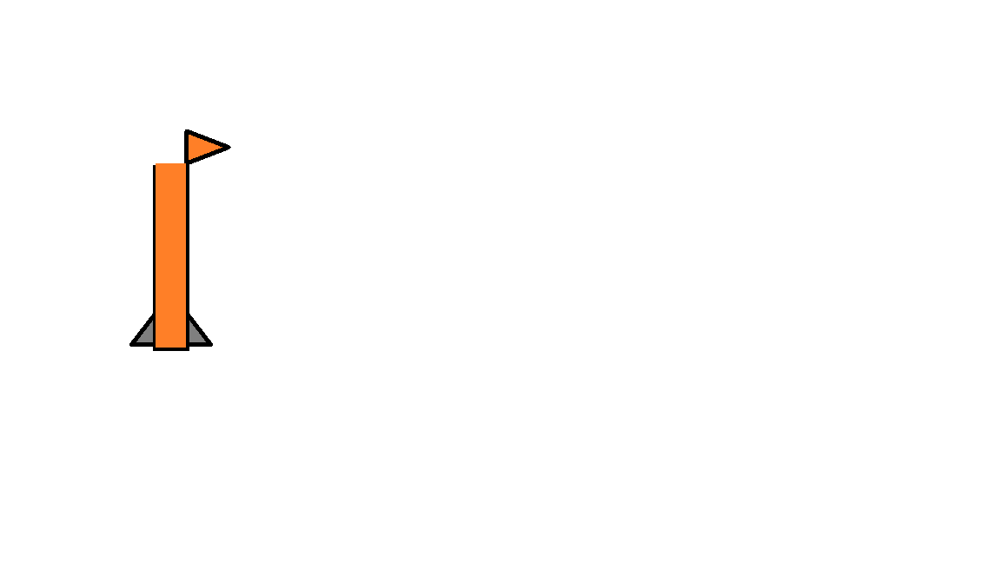
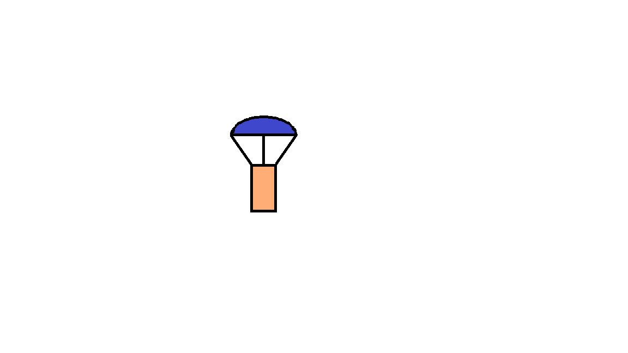
Descent Control Overview (Cnt’d)
1) Altitude = 600 m
Ejection charge deploys CANSAT
from bay as well as nose
cone at apogee. Each has its own
descent control system.
2) Altitude = 600→500m
CANSAT (C+P) descends
via parachute at a predicted rate of 10.7 m/s
Presenter: Patrick Guillaume

Slide 29
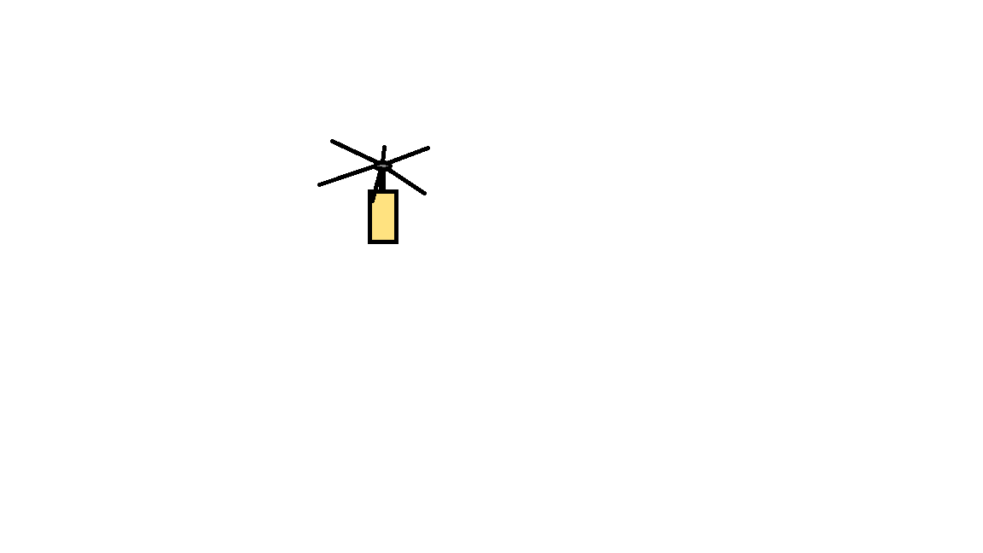

Descent Control Overview (Cnt’d)
3) Altitude = 500 m
CANSAT P deploys blades. CANSAT C Still attached to parachute. Blades open up cache some air and start to rotate providing a net upward force for a terminal velocity in the range 4m/s<Vter<10m/s
4) Altitude = 500 m to 0 m
CANSAT P continues to descend with blades and comes in contact with ground. C lands with parachute.
Presenter: Patrick Guillaume

Slide 30
Descent Control Changes Since PDR
No changes since PDR
Prototype not yet tested
Reason: delay in acquiring materials due to funding
Presenter: Patrick Guillaume

Slide 31
Descent Control Requirements
ID | Req. No | REQUIREMENT
DCSR-01 | 4 | The Container shall use a passive descent control system. It cannot free fall. A parachute is allowed and highly recommended. Include a spill hole to reduce swaying.
DCSR-02 | 10 | The Container or Science Vehicle shall include electronics and mechanisms to determine the best conditions to release the Science Vehicle based on stability and pointing. It is up to the team to determine appropriate conditions for releasing the Science Vehicle.
DCSR-03 | 11 | The Science Vehicle shall use a helicopter recovery system. The blades must rotate. No fabric or other materials are allowed between the blades
DCSR-04 | 12 | All descent control device attachment components shall survive 50 Gs of shock.
DCSR-05 | 13 | All descent control devices shall survive 50 Gs of shock.
DCSR-06 | 29 | The descent rate of the Science Vehicle shall be less than 10 meters/second and greater than 4 meters/second
Presenter: Patrick Guillaume

Slide 32

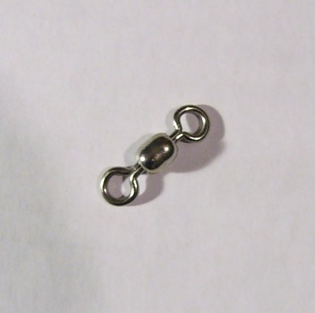
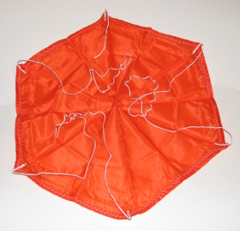
Container Descent Control Hardware Summary
Only passive components used: Parachute, Swivel clip
Color selection: Make apparatus stand out
Key considerations:
Parachute size
Attachment method
Container Descent | 12’’ Parachute
Color | Neon pink
Descent Control Capability (CanSat weight: 660g) | ≈11 m/s
Weight | ≈3g
Cost | $10
Preflight Review Testability | Will be tested using object of similar mass
Shock Force Survival (withstand 30Gs) | Kevlar thread (tensile strength: 3620 MPa) Swivel clip (able to survive 160kg pull )
DCS Connections | Follows DCS rules
Presenter: Patrick Guillaume

Slide 33
Payload Descent Control Hardware Summary
Only Passive components: Auto-gyro blades and rotor
Key Considerations:
Blade Profile Blade Material
Blade Dimensions Number of Blades
Payload Descent | Auto-gyro
Profile | SG6043
Material | Carbon Fiber
Size | Blade Length: 6in
Color | Black
Weight | ≈64g
Trigger | Blades deploy when released from C
Preflight Review Testability | Decent system will be tested in wind tunnel
Survivability (30Gs) | Awaiting Testing
DCS Connections | Follows DCS rules
Presenter: Patrick Guillaume

Slide 34
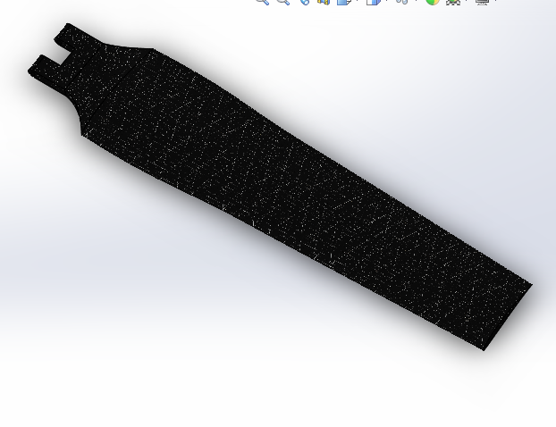
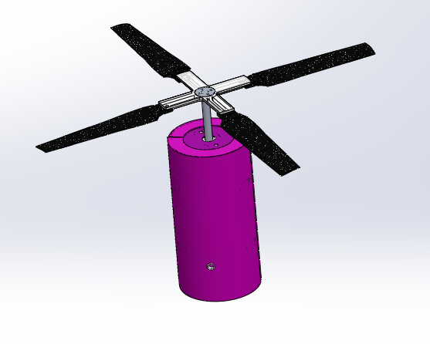
Payload Descent System
Blade Length: 6in
Material: Carbon-Fiber
Presenter: Patrick Guillaume

Slide 35
Descent Rate Estimates (CanSat)
Calculations used for CANSAT (C+P) Descent
CanSat descent will be dictated by the carrier parachute
Approximate CANSAT descent rate can be determined from the following equation:
$$V_{terminal}=\sqrt{\frac{8mg}{πρC_{D}D^{2}}}$$
With:
Parachute Diameter $D=0.457m$
Coefficient of Drag: $C_{D}=1.3$
CanSat Mass: $m=660g$
Gravitational acceleration: $g=9.81m/s^{2}$
Air density: $ρ=1.2kg/m^{3}$
From this we find:
$$V_{terminal}=10.7m/s$$
Presenter: Patrick Guillaume

Slide 36
Descent Rate Estimates (Container)
Calculations used for Container Descent
Container descent (after payload deploys) will be dictated by the carrier parachute
Approximate Container descent rate can be determined from the following equation:
$$V_{terminal}=\sqrt{\frac{8mg}{πρC_{D}D^{2}}}$$
With:
Parachute Diameter $D=0.457m$
Coefficient of Drag: $C_{D}=1.3$
Container Mass: $m≈230g$
Gravitational acceleration: $g=9.81m/s^{2}$
Air density: $ρ=1.2kg/m^{3}$
From this we find:
$$V_{terminal}=4.2m/s$$
Presenter: Patrick Guillaume

Slide 37
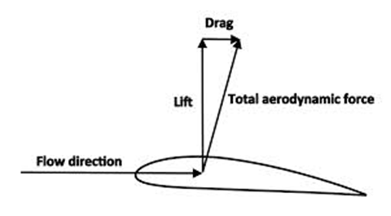
Descent Rate Estimates
AutoGyro requires asymmetric airfoil SG-6043 Blade Profile
The blades are at a negative angle of attack relative to the rotor disk the air moving up through the rotor captures energy like a wind turbine.
Rotational Energy is dissipated through the generation of aerodynamic lift by the blades.
Cannot solve it analytically. Numerical approximation is required
$${dF}_{L}=\frac{1}{2}ρC_{L}V^{2}dA$$
$${dF}_{θ}={dF}_{L}\sin\left(α\right)−{dF}_{D}\cos\left(α\right)$$
$$dF_{v}={dF}_{L}cos⁡(α)+dF_{D}\sin\left(α\right)$$
$${dF}_{D}=\frac{1}{2}ρC_{D}V^{2}dA$$
$$Where :$$
$$F_{θ} and F_{v} are the forces in the rotational and vertical directions respectively$$
$$F_{L} and F_{D} are the Lift and Drag forces respectively$$
$$C_{L} and C_{D} are the Lift and Drag Coefficients respectively$$
$$α is the angle of attack$$
Presenter: Patrick Guillaume
CanSat 2015 CDR: Team 4996 (Phoenix)
37

Slide 38
Descent Rate Estimates
Solving equations
2 softwares used: Fluent and Matlab
Fluent: Simulations run in Fluent to determine range of Cd and Cl values at various Reynold’s number and angle of attacks
Assumptions:
No crosswind
Steady flow
Constant air density
Constant dynamic viscosity
Constant air pressure
Matlab: Matlab code estimates velocity on impact with ground
Assumptions:
No crosswind
Constant density
Presenter: Patrick Guillaume
CanSat 2015 CDR: Team 4996 (Phoenix)
38

Slide 39
Descent Rate Estimates
Fluent
Inputs for Fluent:
x and y component of velocity for given Reynold’s number
x and y components of local Cd and Cl values for given angle of attack
Outputs for Fluent:
Average Cd and Cl values
Results:
Value ranges
Cd:(0.00194-1.32)
Cl: (-0.268 - 1.321)
Presenter: Patrick Guillaume
CanSat 2015 CDR: Team 4996 (Phoenix)
39

Slide 40
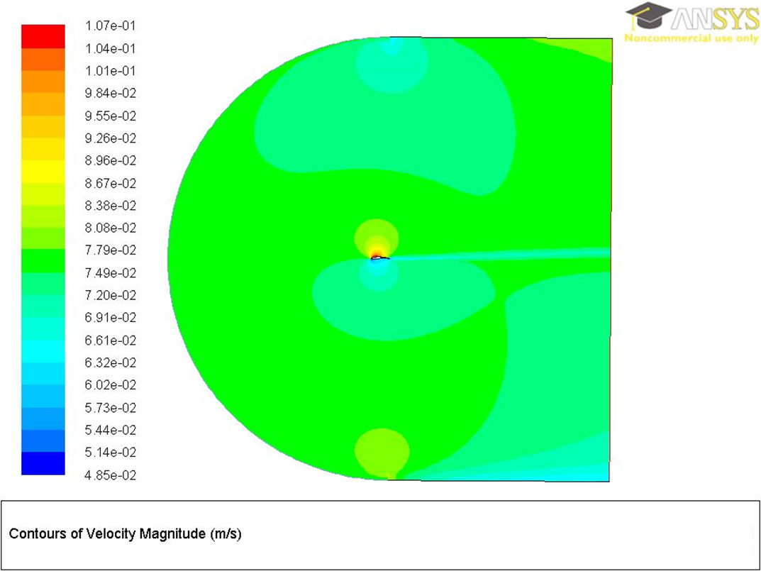
Descent Rate Estimates
Velocity Contour Plot
Presenter: Patrick Guillaume

Slide 41
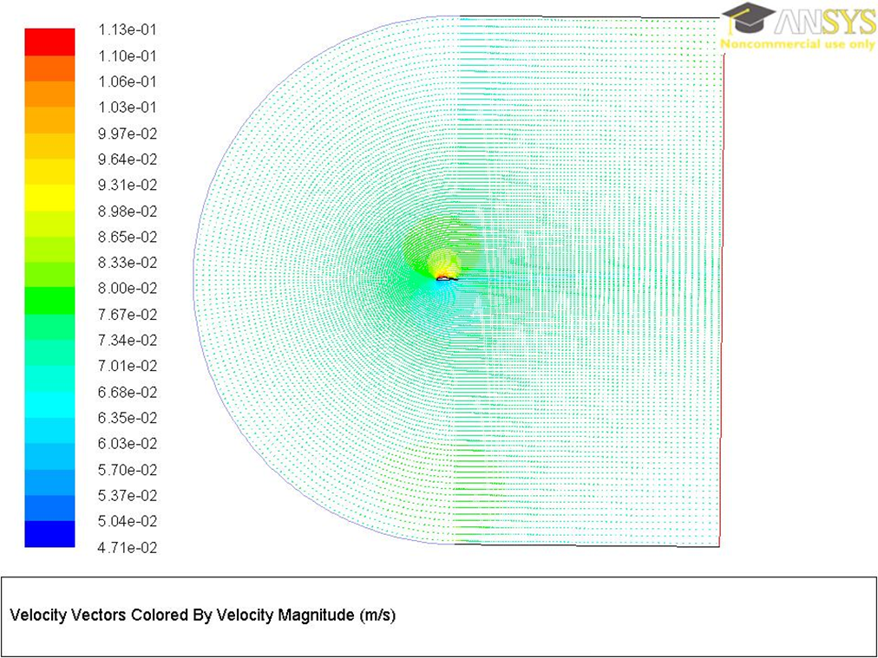
Descent Rate Estimates
Velocity Vector Plot
Presenter: Patrick Guillaume

Slide 42
Descent Rate Estimates
Matlab
Algorithm:
CD and CL values used to calculate Forces on differential segments of the blade
Forces are then integrated along the length of the blade
Forces are broken into Tangential (Rotational) and Vertical components
Vertical and Angular accelerations are computed
Velocities for the next time step are computed
Process is repeated until terminal velocity is reached
Output:
Approximate terminal velocity obtained 4.3 m/s
Time to reach terminal velocity: 18s
Presenter: Patrick Guillaume

Slide 43
Mechanical Subsystem Design
Majlinda Malellari

Slide 44
Mechanical Subsystem Overview
Parachute Link
Descent System
Material Selection
Container and Science Vehicle: Kevlar and Fiberglass
Hub and connectors: Nylon and ABS plastic
Egg Protection: Cardboard
Egg Protection Mat: Polystyrene
Descent Mount
PCB
Container
Egg Protection
Science Vehicle
Release Mechanism
Camera
Presenter: Majlinda Malellari

Slide 45
Mechanical Subsystem Changes Since PDR
There were no changes made since the PDR

Slide 46
Mechanical Sub-System Requirements
ID | Req. NO̊ | Requirement
MSR-01 | 1 | Complete mass of CanSat will be 600 grams +/- 10 grams (without the egg)
MSR-02 | 2-3 | The Science Vehicle shall be completely contained in the container. The container shall fit in the envelope of 125 mm x 310 mm.
MSR-03 | 4-6 | The container shall use a passive descent system (ex. parachute). No sharp edges on the Container and the body shall be a florescent color.
MSR-04 | 11 | The Science Vehicle shall use a auto-gyro recovery system. No fabric can be used between the blades.
MSR-05 | 12-13 | All the descent control device attachment components shall survive 50 Gs od shock.
MSR-06 | 15-16 | All the structures shall be built to survive 15 Gs acceleration, and 30 Gs of shock.
MSR-07 | 18 | All mechanism shall be able to maintain their configuration under all forces.
MSR-08 | 19 | No pyrotechnics or chemicals allowed.
MSR-09 | 31 | Cost of the CanSat shall be under $1000.
Presenter: Majlinda Malellari

Slide 47
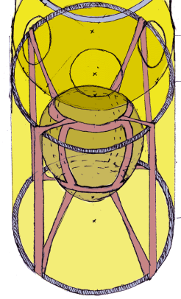

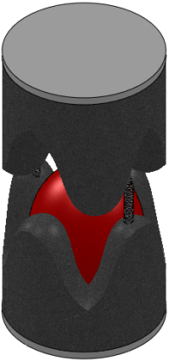
Egg Protection Trade & Selection
Egg Protection (EP) Egg is strongest when force is applied along higher vaulted arc Test using a statistical approach to determine best overall solution. We chose Polystyrene because it is easy to manufacture, and it is light weight. |  | Elastic Support |  | Oobleck |  | Polystyrene
Criteria | Weight | Rating | Reason | Rating | Reason | Rating | Reason
Integration | 30% | 3 | Suspended fabric pouch | 2 | Requires water tight container | 4 | Egg crate foam cut to size
Damping Effect | 50% | 4 | Compresses egg along main arcs | 4 | Highly viscous | 4 | Spreads force over entire surface
Size/Mass | 20% | 4 | Lightweight fabric and elastic | 2 | Avg size, very heavy | 4 | Large volume & lightweight
Total Score | 100% | 3.7 |  | 3.6 |  | 4
Rank |  | 2 |  | 3 |  | 1
Decision |  | DECLINE |  | DECLINE |  | ACCEPT
Presenter: Majlinda Malellari

Slide 48
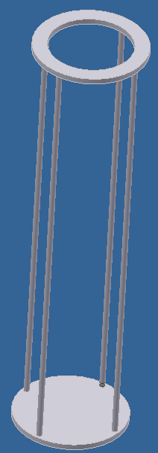
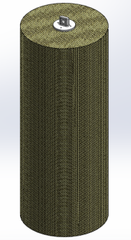
Mechanical Layout of Components Container: Trade & Selection
Reentry Container Chassis |  | Column & Plate Frame |  | Kevlar, Fiberglas & Epoxy Structural Shell
-We chose this because: Primary structural support for CanSat Design requirements: impact resistant, workable, lightweight, full enclosure
Criteria | Weight | Rating | Reason | Rating | Reason
Workability | 30% | 4 | Columns and plastic shell are easily made | 3 | OK for simple shapes
Impact Resistance | 50% | 2 | Columns deform, plastic is brittle | 5 | Kevlar and Fiberglas is impact resistant
Size/Mass | 20% | 3 | Lightweight, multiple plates are heavy | 4 | Kevlar and Fiberglas is dense and has minimum thickness
Total Score | 100% | 3.0 |  | 4.0
Rank |  | 2 |  | 1
Decision |  | Decline |  | Accept
Presenter: Majlinda Malellari

Slide 49
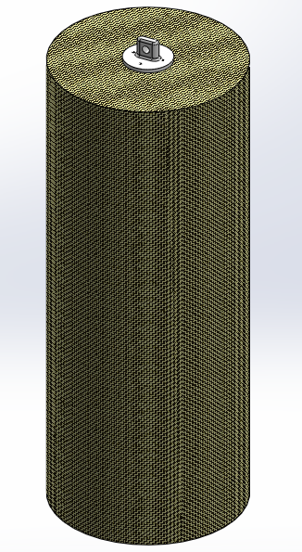
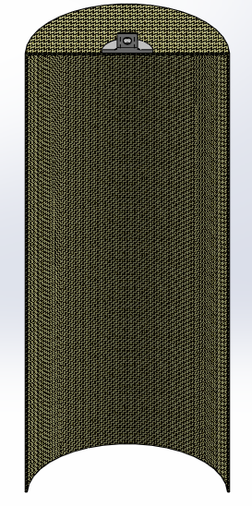
Re-Entry Container Shell
Full View of Container (without paint)
Section View (without paint)
Presenter: Majlinda Malellari

Slide 50
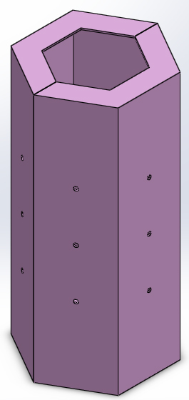
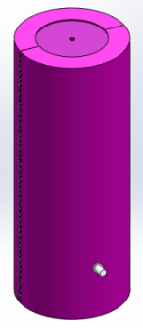
Mechanical Layout of Components Science Vehicle: Trade & Selection
Science Payload Chassis (shape) |  | Hexagonal |  | Cylindrical
We chose this because it will: Increase aerodynamic effect Utilize maximum spacing for components Circular shape provides less stress conentration
Criteria | Weight | Rating | Reason | Rating | Reason
Strength | 30% | 2 | Stress concentrates on edges | 4 | Cylindrical shape dissipates stress
Drag | 30% | 4 | Fluent simulation shows no differences | 4 | Fluent simulation shows no differences
Component Spacing | 40% | 3 | More spacing | 3 | Reasonable attachment on curved surfaces
Total Score | 100% | 3.0 |  | 3.7
Rank |  | 2 |  | 1
Decision |  | DECLINE |  | ACCEPT
Presenter: Majlinda Malellari

Slide 51
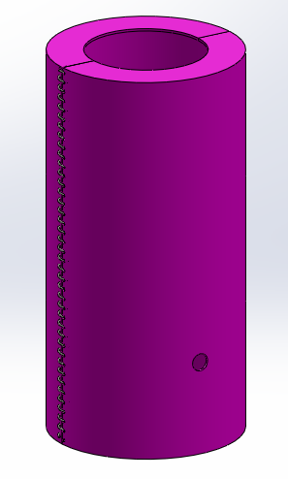
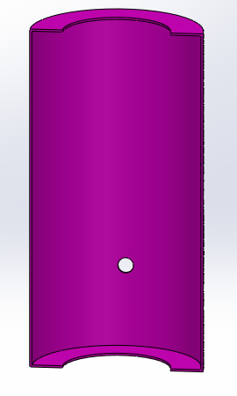
Science Payload Shell
Science Vehicle (Section view)
Science Vehicle
Presenter: Majlinda Malellari

Slide 52
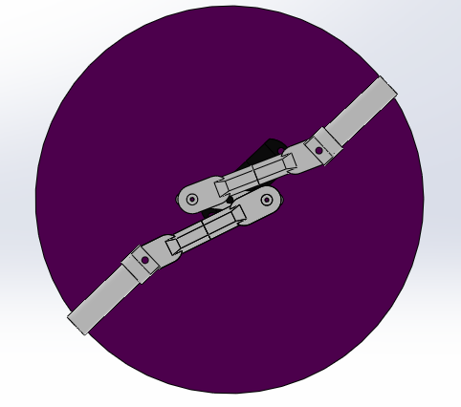
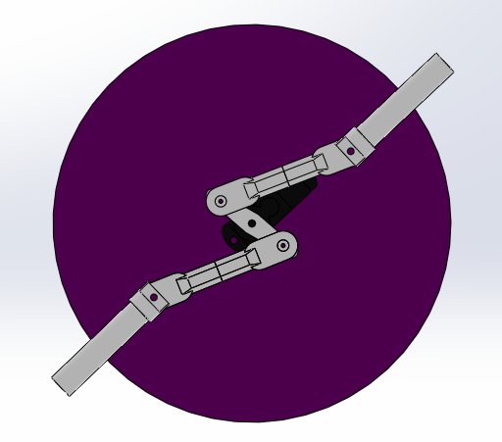
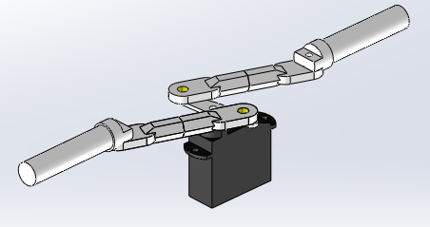
Mechanical Layout of Components Release Mechanism: Trade & Selection
Pivot Release
Retracted (detach from container)
Enforced (connected to the container)
Release without support plate
Presenter: Majlinda Malellari

Slide 53
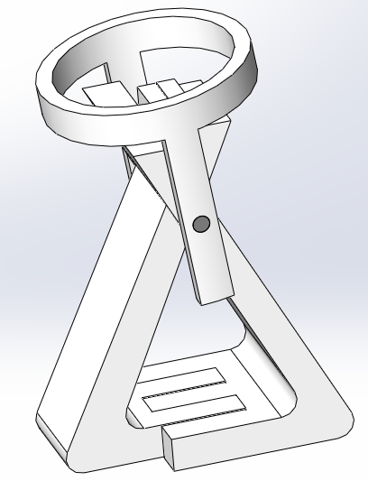
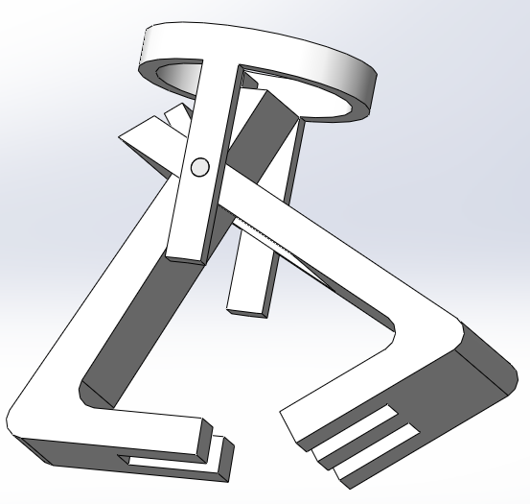
Mechanical Layout of Components Release Mechanism: Trade & Selection
Claw Release
Open
Closed
Presenter: Majlinda Malellari

Slide 54
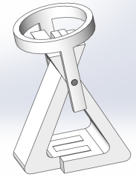

Mechanical Layout of Components Release Mechanism: Trade & Selection
Release Mechanism |  | Claw Lock |  | Pivot Release
We chose this because: Simple & Efficient Easy to mount and compact
Description |  | Servo triggered in combination with spring load |  | Servo Triggered, linkage connection within mechanism
Criteria | Weight | Rating | Reason | Rating | Reason
Simplicity | 30% | 3 | Many parts | 3 | Many parts.
Easy to Manufacture and Feasibility | 40% | 4 | Few parts to manufactures | 4 | Few parts will be manufactured, most parts will be purchased
Component Spacing & Placement | 20% | 2 | Hard to mount servo and the overall mechanism | 4 | Servo mounted on fiberglass plate
Total Score | 100% | 3.00 |  | 3.70
Rank |  | 2 |  | 1
Decision |  | DECLINE |  | ACCEPT
Presenter: Majlinda Malellari

Slide 55
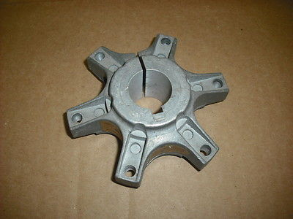
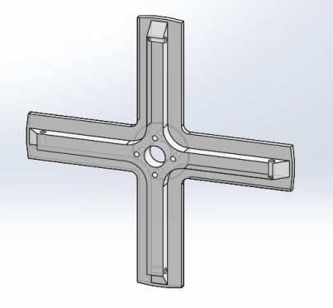
Material Selections for Descent System: Rotor Hub
Rotor Hub Material |  | Aluminum |  | Nylon
Primary attachment point for the blades of the Autorotation Subsystem Must accommodate four blades and fit within a cylinder of 130mm diameter Design requirements: impact resistant, strong, workable, lightweight,
Criteria | Weight | Rating | Reason | Rating | Reason
Workability | 20% | 3 | More easily machined | 3 | Susceptible to breakage during machining
Strength | 50% | 4 | Low chance of plastic deformation | 3 | Very strong, but less than aluminum
Size/Mass | 30% | 2 | Very dense, heavy | 4 | Lightweight
Total Score | 100% | 3.0 |  | 3.3
Rank |  | 2 |  | 1
Decision |  | Decline |  | Accept
Presenter: Majlinda Malellari

Slide 56
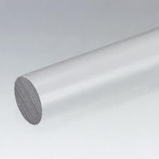
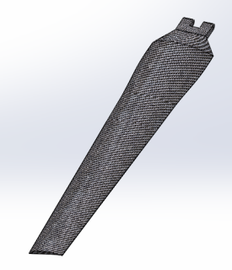
Material Selections for Descent System: Blade Material
Blade System |  | 305 Polyurethane |  | Carbon Fiber
Hollow Carbon Fiber material. Strong and light. Test using a statistical approach to determine best overall solution.
Criteria | Weight | Rating | Reason | Rating | Reason
Rigidity | 20% | 3 | Test result | 4 | Reasonable rigidity and high heat tolerance
Density | 30% | 3 | Test result | 3 | Good
Yield Strength | 20% | 2 | Test result | 3 | Good Tensile strength
Size/Mass | 30% | 2 | Heavy | 4 | Light Weight
Total Score | 100% | 2.5 |  | 3.5
Rank |  | 2 |  | 1
Decision |  | Decline |  | Accept
Presenter: Majlinda Malellari

Slide 57
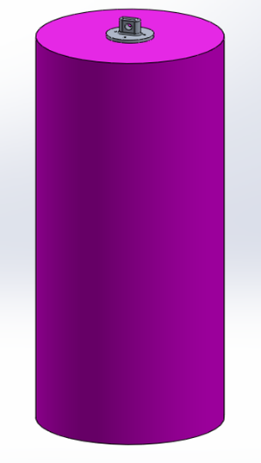
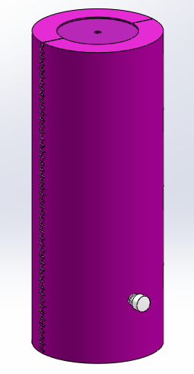
Material Selections Payload & Container Shells
Material: Resin enforced Kevlar and Fiberglas Fabric
Reasons:
Light weight
Shock force resistance, durability and strength due to woven composition of Kevlar fabric and its high strength to weight ratio
Resin reinforced
Container
Payload
Presenter: Majlinda Malellari

Slide 58
Container - Payload Interface
Servo will be attached into a fiberglass plate
Arms will be pushing into the inner surface of container as the servo is originally placed into right position
As the servo is being triggered the Arms will retract inside the Science Vehicle allowing it to detach itself from the container and separate for descent
Note: Support plate for the release mechanism is not included
Arm Cap
Link Couples
Arm
Servo
Presenter: Majlinda Malellari
58

Slide 59
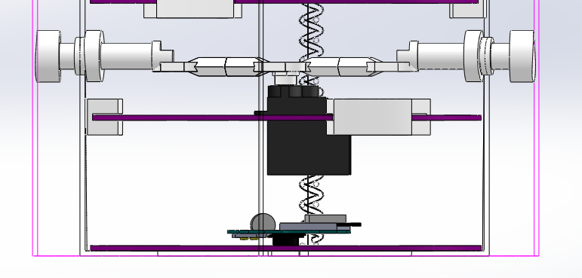
Container - Payload Interface Cont’d
Arm Cap
Link Couple
Arm
Arm support attached to the inner wall of container
Container wall (wireframe display)
Arm support attached to the wall of Payload
Slot
(for reinforcing plate)
Mechanism support plate
Science Vehicle wall (wireframe display)
Servo
Camera
Arm cap and Arm supports will be 3D printed and the material that will be used ABS plastic
Presenter: Majlinda Malellari
59

Slide 60
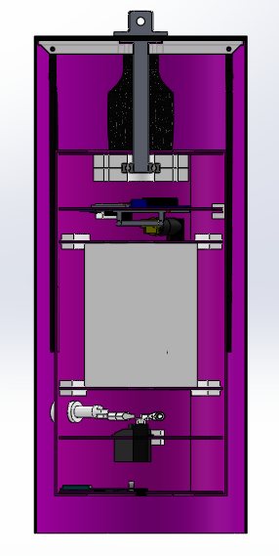
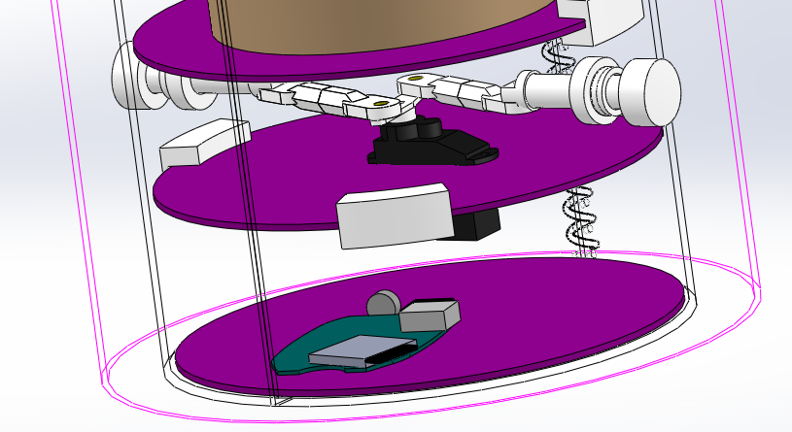
Container - Payload Interface Cont’d
Full view of CanSat
Additional view of the Pivot Release (Parts indicated on the pervious slide)
Presenter: Majlinda Malellari
60

Slide 61
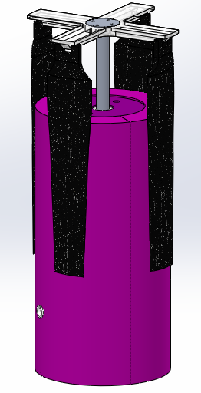
Deployment of Descent Control System
The rotor blades will be in a closed position while Science Vehicle is pared with the Container
At separation from container, blades will open and be held on that position due to the spring attachment into the hub-blade interference
Presenter: Majlinda Malellari
61

Slide 62
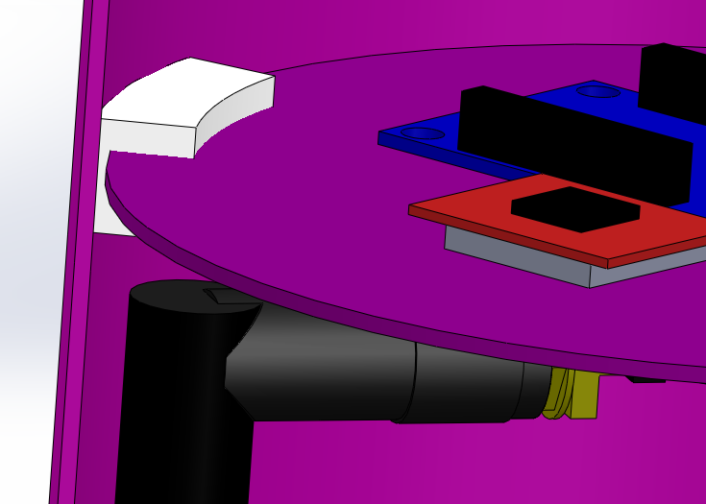
Structure Survivability Trades: Electronics Enclosures and Connections
Electronics mounted onto PCBs
PCBs mounted to payload via slots enclosed in payload shell
Payload is enclosed in a container
Presenter: Majlinda Malellari
CanSat 2015 CDR: Team 4996 (Phoenix)
62

Slide 63
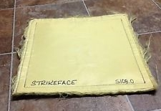

Structure Survivability Trades: Electronics Mount
Payload Mounting Plate Material |  | Kevlar Panel |  | PCB
Primary structural support for Payload interior components: Electronics, antennae, egg enclosure, etc. 125mm diameter Design requirements: impact resistant, workable, lightweight, full enclosure, withstand force from 30 G’s of acceleration
Criteria | Weight | Rating | Reason | Rating | Reason
Workability | 20% | 4 | Easily cut to size | 5 | Simplifies layout
Impact Resistance | 50% | 5 | Impact resistant | 4 | Mount brackets will ensure stability
Size/Mass | 30% | 3 | Lightweight | 5 | Very lightweight and eliminates wiring weight
Total Score | 100% | 4.2 |  | 4.5
Rank |  | 2 |  | 1
Decision |  | Decline |  | Accept
Presenter: Majlinda Malellari
CanSat 2015 CDR: Team 4996 (Phoenix)
63

Slide 64
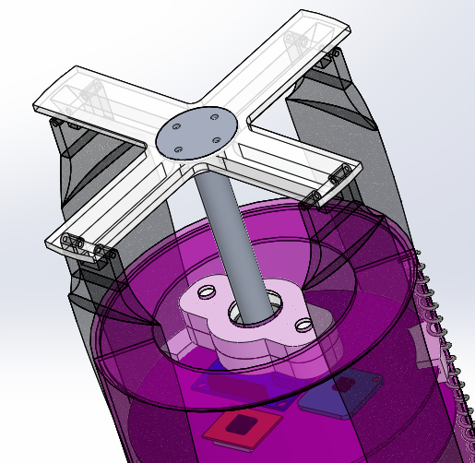
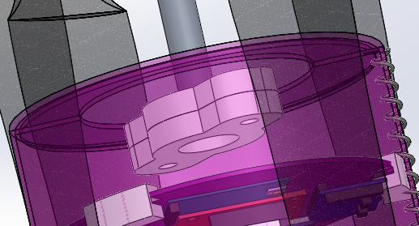
Structure Survivability Trades: Descent Control Mount
Hub
Blade
Bottom View of the Mount
Shaft
Descent Mount
The mount will be placed inside the Science Vehicle and attached to it via screws.
Presenter: Majlinda Malellari
CanSat 2015 CDR: Team 4996 (Phoenix)
64

Slide 65


Structure Survivability Trades: Descent Control Mount (Cont’d)
Descent Mount
composed of three parts:
Top Housing
Bottom Housing
Ball Bearing
Top Housing
Ball Bearing
Bottom Housing
Note: Top shown transparent for better inner view
Presenter: Majlinda Malellari
CanSat 2015 CDR: Team 4996 (Phoenix)
65

Slide 66
Structure Survivability Trades: Testing
Testing has not yet been performed to determine if structure and connections can resist 30 Gs of shock and 15 Gs of acceleration.
Electronic plates mounts are planned to be tested under a vibrations test.
Thermal Test will also be performed to ensure survivability of the system in a hot environment.
Presenter: Majlinda Malellari
CanSat 2015 CDR: Team 4996 (Phoenix)
66

Slide 67
Mass Budget (Container)
Component | Mass per unit (g) | Quantity | Grand Mass (g) | Source/Uncertainties
Chassis | 219.9 | 1 | 209.9 | Estimates
Parachute attachment link | 7.3 | 1 | 7.1 | Estimates
Parachute with hook | 20.6 | 1 | 20.6 | Estimates
Total Container Mass: 247.8 grams
Presenter: Majlinda Malellari
CanSat 2015 CDR: Team 4996 (Phoenix)
67

Slide 68
Mass Budget (Payload)
Component | Mass per unit (g) | Quantity | Grand Mass (g) | Source/Uncertainties
Chassis | 98.16 | 1 | 98.16 | Estimates
Plates | 6.24 | 6 | 37.44 | Estimated
Arm Supports | 0.35 | 2 | 0.7 | Estimated
Arm Caps | 0.13 | 2 | 0.26 | Estimated
Egg Protection System | 20 | 1 | 20 | Measured
PCB | 8.46 | 1 | 8.46 | Estimates
Plate bracket | 1.17 | 9 | 10.53 | Estimates
Spring | 3.85 | 1 | 3.85 | Estimates
Descent Mechanism | 64.54 | 1 | 64.54 | Estimates
Descent Mount | 13.8 | 1 | 13.8 | Estimates
Total Payload Mass: 258.19 grams
Presenter: Majlinda Malellari
CanSat 2015 CDR: Team 4996 (Phoenix)
68

Slide 69
Mass Budget (Electronics)
Component | C or P | Mass per unit (g) | Quantity | Grand Mass (g) | Source/Uncertainties
Arduino Pro Mini | P | 3.8 | 1 | 3.8 | Manufacturer's specs
ADXL345 | P | 2.2 | 1 | 2.2 | Manufacturer's specs
BMP 180 | P | 1.6 | 1 | 1.60 | Manufacturer's specs
XBEE | P | 8.37 | 1 | 8.37 | Manufacturer's specs
Breakout Board | P | 2.03 | 1 | 2.03 | Manufacturer's specs
TMP36 | P | 1.5 | 1 | 1.5 | Manufacturer's specs
Antenna | P | 14 | 1 | 14 | Manufacturer's specs
Battery | P | 60 | 1 | 60 | Measured
Servo | P | 4.7 | 1 | 4.7 | Measured
Total Electronics Mass: 98.2 grams
Presenter: Majlinda Malellari
CanSat 2015 CDR: Team 4996 (Phoenix)
69

Slide 70
Mass Budget (Summary)
CanSat Section | Mass (g)
Container | 247.8
Payload (including descent mechanism and descent mount) | 258.19
Electronics | 98.2
Total Mass (without egg) | 604.19
Presenter: Majlinda Malellari
CanSat 2015 CDR: Team 4996 (Phoenix)
70

Slide 71
Communication and Data Handling Subsystem Design
Demetrios Doumas

Slide 72
CDH Overview
Communication Data Handling components:
Sensors | Role
Arduino Pro Mini 5 volt | Micro Controller
Xbee Series 3 | Radio Transmitter
ADXL345 | Read x, y, z acceleration of the CanSat
BMP180 | Calculate inside temperature and altitude
TMP36 | Calculate Outside temperature.
900MHz 3 dBi Rubber Duck Antenna | Send telemetry data over a far range

Slide 73
CDH Overview (Continue)
Sensors | Role
Luminosity sensor TSL2561 | Is needed to check rocket deployment
Chronodot | Is needed to fix mission time if a processor reset has happen.
24LC256 EEproms | Store external time from Chronodot

Slide 74





CDH Overview (Continue)
Sensors | Picture
Arduino Pro Mini 5 volt
Xbee Series 3
LSM303DLH 3-Axis Electronic Compass Accelerometer Module Compass Sensor
BMP180
TMP36

Slide 75




CDH Overview (Continue)
Sensors | Picture
900MHz 3 dBi Rubber Duck Antenna
Luminosity sensor TSL2561
Chronodot
24LC256 EEproms

Slide 76
CDH Changes Since PDR
Changes:
1.) Added the Chronodot and 24LC256 EEproms in case of a processor reset.
2.) Replace the ADXL345 with the LSM303DLH 3-Axis Electronic Compass Accelerometer Module Compass Sensor
The LSM303DLH will help track the cameras movement.

Slide 77
CDH Requirements
ID | Req. No | REQUIREMENT
CDHR-01 | 21 | During descent, the Science Vehicle shall collect and telemeter air pressure (for altitude determination), outside and inside air temperature, flight software state, battery voltage, and bonus objective data (accelerometer data and/or rotor rate).
CDHR-02 | 22 | The Science Vehicle shall transmit telemetry at a 1 Hz rate.
CDHR-03 | 23 | Telemetry shall include mission time with one second or better resolution, which begins when the Science Vehicle is powered on.
CDHR-04 | 24 | XBEE radios shall be used for telemetry. 2.4 GHz Series 1 and 2 radios are allowed. 900 MHz XBEE Pro radios are also allowed.
CDHR-05 | 25 | XBEE radios shall have their NETID/PANID set to their team number (decimal).
CDHR-06 | 26 | XBEE radios shall not use broadcast mode.
CDHR-07 | 27 | The Science Vehicle shall have a video camera installed and recording the complete descent from deployment to landing. The video recording can start at any time and must support up to one hour of recording.
Presenter: Demetrios Doumas

Slide 78
CDH Requirements Cont’d
ID | Req. No | REQUIREMENT
CDHR-08 | 28 | The video camera shall include a time stamp on the video. The time stamp must work from the time of deployment to the time of landing.
Presenter: Demetrios Doumas

Slide 79
Processor & Memory Trade & Selection
Criteria | Weight | Arduino Pro Mini 5V (ATmega328) | Grade | Pro Micro 5V (ATmega32U4) | Grade
Processor speed | 20% | 16MHz | 3 | 16MHz | 3
Data interfaces | 20% | Digital: 14 Analog: 8 PWM: 6 | 4 | Digital: 12 Analog: 10 PWM: 5 | 3
Flash Memory | 20% | 32KB | 3 | 32kB | 3
Size | 20% | 39x18mm (w/ FTDI adapters) | 4 | 33x17.7mm | 5
Cost | 20% | $9.95 | 5 | $19.95 | 4
Weighted Total | 100% |  | 3.8 | Does not need FTDI adapters | 3.6
Presenter: Demetrios Doumas

Slide 80
Processor & Memory Trade & Selection
Selected Arduino Pro Mini 5V
1.) Cost less than the Pro Micro 5V (ATmega32U4)
2.) Has more Digital interfaces than the Pro Micro 5V (ATmega32U4)

Slide 81
Real-Time Clock
The flight software on the 5 volt Arduino pro mini will keep track of time throughout the flight time.
The external clock (Chronodot) will be running in parallel.
If the processor resets then the flight state is retrieved from the EEproms and the time from the Chronodot will be saved to mission time.

Slide 82






Antenna Trade & Selection
Criteria | Weight | SFE Cellular Helical Antenna | Grade | SFE 900MHz Duck Antenna | Grade | HyperLink HG903D-RSP | Grade
Frequency | 30% | 900-1990 MHz | 5 | 900/1800 MHz | 5 | 860-960 MHz | 5
Gain | 20% | 2 dbi | 4 | 2 dbi | 4 | 3 dbi | 3
VSWR | 30% | < 3 | 2 | <1.8 | 5 | <2 | 4
Radiation Pattern H-Plane E-Plane | 20% |  | 4 |  | 3 |  | 4
Weighted Total |  |  | 3.7 |  | 4.4 |  | 4.1
Presenter: Demetrios Doumas

Slide 83
Antenna Trade & Selection
Selected SFE 900MHz Duck Antenna
1.) Low gain of 2 dbi, which means more coverage on the H-plane.
2.) Has a low voltage standing wave ratio, which means less power loss of the signal coming from the xbee radio transmitter.

Slide 84
Radio Configuration
The XBee-PRO 900MHz XSC S3B radios will be configured with the XCTU -firmware.
Modem ID will be the Team ID.
When powered on, the XBee will automatically join network. No management needed.
Presenter: Demetrios Doumas

Slide 85
Telemetry Format
Data Included:
Team-ID -Mission Time
Altitude -Outside Temperature
Inside Temperature -Voltage
Flight state - X,Y,Z Acceleration
Data format: <TeamID>,<MissionTime>,<Altitude>,<Outside Temperature>,<Inside Temperature>,<Voltage>,<Flight State> <3-AxisAccel(tilt)>
Data rate:
9600 (bytes per second)
Continuous transmission
Presenter: Demetrios Doumas

Slide 86
Electrical Power Subsystem Design
Joel Annenberg

Slide 87
EPS Overview
Payload:
9V Battery– power source
1k ohm voltage divider – for voltage sensing
TL431 diode - voltage reference for precision voltage sensing
3V CR1632 lithium coin cell – to power external clock
LEDs – to verify payload status
Container:
No electronics in container
Presenter: Joel Annenberg

Slide 88
EPS Overview Continued
Power Source
9V
Umbilical cord
Arduino regulated 5V
XBee regulated 5V
Sensors:
Accel, Temps, BMP
Servo 3-5V
LEDs
Presenter: Joel Annenberg

Slide 89
EPS Changes Since PDR
Change | Reason
Added 3V coin cell | Required to power the external clock that was added to the electrical system
Added external voltage reference | Increase accuracy of voltage measurement
Power requirements changed | Added more sensors, which led to the consumption of more power
Presenter: Joel Annenberg

Slide 90
EPS Requirements
ID | Req. No | REQUIREMENT
EPSR-01 | 42 | The Science Vehicle shall include an easily accessible power switch which does not require removal from the Container for access. An access hole or panel in the Container is allowed.
EPSR-02 | 43 | The Science Vehicle must include a battery that is well secured.
EPSR-03 | 44 | Lithium polymer cells are not allowed due to being a fire hazard.
EPSR-04 | 45 | Alkaline, Ni-MH, lithium ion built with a metal case, and Ni Cad cells are allowed.
Presenter: Joel Annenberg

Slide 91
Electrical Block Diagram (Payload)
Power Source
9V
An externally accessible switch will be installed between the 9V battery and the microcontroller.
A power umbilical cord will be attached to the microcontroller to allow for testing
LEDs will be externally visible for status verification (for testing only)
Sensors are all rated for use with 5V power (some regulate voltage down to 3.3V).
Umbilical cord
Arduino regulated 5V
XBee regulated 5V
Sensors:
Accel, Temps, BMP
Servo 3-5V
LEDs
Presenter: Joel Annenberg

Slide 92
Electrical Block Diagram: Container
There will be no container electronics, as all of the required electronics will be contained in the payload.
Presenter: Joel Annenberg

Slide 93
Power Source Trade & Selection (Payload)
Criteria | Weight | Energizer Advanced | Grade | Duracell Coppertop | Grade
Weight | 75% | 33.9 g | 4 | 45 g | 2
Price | 25% | $5.99 | 3 | $3.99 | 4
Weighted Total | 100% |  | 3.75 |  | 2.50
Presenter: Joel Annenberg

Slide 94
Power Source Summary
Payload Power Source:
Energizer Advanced Lithium Alkaline
9V @ 150mA
46.4 x 26.5 x 17.5 mm
33.9g / unit
$5.99 / unit
Powerful, light, reliable
Container Power Source:
None
Presenter: Joel Annenberg

Slide 95
Payload Power Source Selection and Design
Power will be generated from 1 Energizer Advanced Lithium-Alkaline 9V Battery (9V @ 150 mA min.)
Supplies ample power and is lighter and more reliable than traditional 9V batteries.
Total power consumption will be 606.48 mW out of a total availability of 1350 mW.
Presenter: Joel Annenberg

Slide 96
Power Budget (Payload)
Components | Power Consumed | Duty Cycle | Source | Total Power Consumed
Arduino | 15.8 mW | 14% | Measurement | 2.6 mWh
Xbee Pro XSC 900MHz (P.L.2) | 126.7 mW | 14% | Measurement | 20.7 mWh
Accelerometer & Magnetometer LSM303 | 0.363 mW | 14% | Data Sheet | 0.061 mWh
Barometer BMP180 | .05 mW | 14% | Data Sheet | 0.008 mWh
Servo | 396 mW | ~0% | Measurement | 0.11 mWh
LED | 66 mW | 14% | Data Sheet | 11 mWh
Temperature Sensor TMP36 | 0.25 mW | 14% | Data Sheet | 0.042 mWh
Luminosity Sensor TSL2591 | 1.32 mW | 14% | Data Sheet | 0.22 mWh
 |  |  | Total: | 100.62 mWh
 | Power Available |  |  | Total Power Supplied
9V Battery @ 150 mA | 1350 mW | 100% |  | 225 mWh
Est. Mission Duration: 4200s Est. Powered Time: 600s
Presenter: Joel Annenberg

Slide 97
Flight Software (FSW) Design
Demetrios Doumas

Slide 98

Flight Software

Slide 99
FSW Overview
Language
C programming language
Development Environment
Arduino software (free open source)
FSW Tasks
Record, store and transmit data.
Activate release mechanism at designated altitude.
Camera record descent

Slide 100
FSW Requirements
ID | Req. No | REQUIREMENT
FSWR-01 | 10 | The Container or Science Vehicle shall include electronics and mechanisms to determine the best conditions to release the Science Vehicle based on stability and pointing. It is up to the team to determine appropriate conditions for releasing the Science Vehicle.
FSWR-02 | 21 | During descent, the Science Vehicle shall collect and telemeter air pressure (for altitude determination), outside and inside air temperature, flight software state, battery voltage, and bonus objective data (accelerometer data and/or rotor rate).
FSWR-03 | 22 | The Science Vehicle shall transmit telemetry at a 1 Hz rate.
FSWR-04 | 23 | Telemetry shall include mission time with one second or better resolution, which begins when the Science Vehicle is powered on.
FSWR-05 | 27 | The Science Vehicle shall have a video camera installed and recording the complete descent from deployment to landing. The video recording can start at any time and must support up to one hour of recording.
FSWR-06 | 28 | The video camera shall include a time stamp on the video. The time stamp must work from the time of deployment to the time of landing.
Presenter: Demetrios Doumas

Slide 101
FSW Requirements
ID | Req. No | REQUIREMENT
FSWR-07 | 40 | The CanSat flight software shall maintain and telemeter a variable indicating its operating state. In the case of processor reset, the flight software shall re-initialize to the correct state either by analyzing sensor data and/or reading stored state data from non-volatile memory. The states are to be defined by each team. Example states include: PreFlightTest(0), LaunchWait(1), Ascent(2), RocketDeployment(3), Stabilization(4), Separation(5), Descent(6), and Landed(7).
Presenter: Demetrios Doumas

Slide 102
CanSat FSW State Diagram
States | Conditions | Sensors
Pre-FlightTest (0) | CanSat Boot | External switch
LaunchWait(1) | Passes Pre-FlightTest
Ascent(2) | Change in Altitude is >0 | Accelerometer @ 1Hz, and Pressure Sensor @ 1Hz
Rocket Deployment(3) | Cansat is expose to light | Luminosity sensor TSL2561 @ 1Hz
Stabilization(4) | Accelerometer tilt is closer to zero. | Accelerometer @ 1Hz
Separation(5) | Altitude has reached 300 meters | Pressure Sensor @ 1Hz
Descent(6) | Change in Altitude is <0 | Accelerometer @ 1Hz
Landed(7) | Altitude at ground level | Accelerometer @ 1Hz
Presenter: Demetrios Doumas

Slide 103

CanSat FSW State UML-Diagram

Slide 104
Software Development Plan
A common CanSat problem is late software development
Present a slide describing the plan for software development and plans to reduce the risk of late software development
Include:
Prototyping and prototyping environments
Software subsystem development sequence
Development team
Test methodology
Discuss progress since PDR

Slide 105
Software Development Progress
Progress:
1.) Calculate all required telemetry data.
2.) Able to transmit telemetry data.

Slide 106

Software Development Plan

Slide 107
Ground Control System (GCS) Design
Demetrios Doumas

Slide 108




GCS Overview
Telemetry data flow:
Cansat
Quad-Band Omni-directional Antenna
FG16397
Xbee Series 3
Laptop

Slide 109
GCS Requirements
ID | Req. No | REQUIREMENT
GCSR-01 | 24 | XBEE radios shall be used for telemetry. 2.4 GHz Series 1 and 2 radios are allowed. 900MHZ XBEE Pro radios are also allowed.
GCSR-02 | 25 | XBEE radios shall have their NETID/PANID set to their team number.
GCSR-03 | 26 | XBEE radios shall not use broadcast mode.
GCSR-04 | 32 | Each team shall develop their own ground station.
GCSR-05 | 33 | All telemetry shall displayed in real time during descent.
GCSR-06 | 34 | All telemetry shall be displayed in engineering units (meters, meter/sec, Celsius, etc).
GCSR-07 | 35 | Teams shall plot data in real time during flight on ground station computer.
GCSR-08 | 36 | The ground control station shall include one laptop computer with a minum of two hours of battery operation, XBEE radio and a hand held or table top Antenna.
Presenter: Demetrios Doumas

Slide 110
GCS Requirements Cont’d
ID | Req. No | REQUIREMENT
GCSR-09 | 37 | The ground station shall be portable so the team can be positioned at the ground station operation site along the flight line. AC power will not be available at the ground station operation site.
Presenter: Demetrios Doumas

Slide 111
GCS Antenna
Discussion of the selection of the GCS antenna
Include:
Antenna placement and coverage
Diagram is recommended
Antenna height and mounting strategy
Launch day construction
Distance link predictions and margins
Screen shot of ground control software in operation

Slide 112

Screen shot of ground control software in operation

Slide 113


GCS Antenna Trade selection
Criteria | Quad-Band Omni-directional Antenna FG16397 | Hyper Link Yagi HG903YE | Die Cast Grid Antenna
Gain: | 1dBi | 3dBi | 15dBi
Type: | Omni Directional | Directional | Directional
Cost: | $100 | $30 | $ 90
Weight: | 0.844 lbs | 1.5 lbs | 6.55 lbs
Polarization: | Linear vertical | Horizontal or vertical | Horizontal or vertical
Frequency: | 900MHz | 900MHz | 824~960 Hz
Presenter: Demetrios Doumas

Slide 114
Distance Link and Predictions
The antenna will be mounted as a tabletop antenna during the launch day.
The selected antenna radiation pattern is:
Azimuth
Elevation
The Omni-directional Antenna
FG16397 was chosen because of its 360 degree coverage in the horizontal plane.
Elevation Beamwidth at Half-Power: 90 degrees
Azimuth Beamwidth at Half-Power: 360 degrees
Presenter: Demetrios Doumas

Slide 115
GCS Software
Telemetry display screen shots
Commercial off the shelf (COTS) software packages used
Real-time plotting software design
Data archiving and retrieval approach
Command software and interface
Progress since PDR
Testing

Slide 116
GCS Software
Commercial off the shelf (COTS) software packages used:
Matlab 2013: Creating a Graphic User Interface (GUI).
Arduino: Diagnostic purposes for checking serial port readings.
Presenter: Demetrios Doumas

Slide 117

GCS Software: Flow Chart
Real-time plotting software design:
Presenter: Demetrios Doumas

Slide 118
GCS Software: Data archiving and retrieval approach
Data archiving Steps:
1.) Read data from serial port every 1 Hz.
2.) Save the data in an excel file.
3.) Plot current data on the screen
4.) Repeat
Presenter: Demetrios Doumas

Slide 119
GCS Software Interface
Presenter: Demetrios Doumas

Slide 120
GCS Software: Telemetry
Telemetry data recording and media presentation:
Payload Telemetry Data:
Team id, mission time, alt sensor, outside temperature, inside temperature, voltage, flight state, X, Y, and Z.
X, Y, and Z are accelerometer readings.
Presenter: Demetrios Doumas

Slide 121
Progress Since PDR
Radio communication established between the GCS software and cansat prototype.
GCS software finished

Slide 122
Testing
Indoors:
The electronics are connected directly to the laptop, where the GCS software is reading the data.
Also, test the flight states operation by doing an altitude test inside an elevator.
Outdoors:
The CanSat will be placed in a rocket (similar to the CanSat competition rocket) and released in an open area in Pennsylvania.
Antenna Testing, whether data is being received with the Arduino software

Slide 123
CanSat Integration and Test
Sakif Chowdhury

Slide 124
CanSat Integration and Test Overview
Flight Software
Test Navigation Software
Mechanical Systems
Drop test and Vibration Test
Temperature Test
Sensors
Individual testing for reliability, accuracy, and precision of each sensor
Communications and Data Handling
1 mile line of sight test
Test communication systems
Tests data analysis conducted at ground station
Electrical Power Systems
Measure estimated necessary power
Presenter: Sakif Chowdhury

Slide 125

CanSat Assembly
Assembly of primary components of CanSat:
Container will be housing the Science Vehicle
Science Vehicle is connected to the reentry container via the release
Mechanism
The Electronics Plates are slotted on the upper section on the Payload and the Egg Protection is placed on the bottom section along with the camera.
Container
Descent System
Science Vehicle
PCB
Release Mechanism
Presenter: Sakif Chowdhury

Slide 126
Integration and Testing Goals
Current Goals
To be able to complete most of the manufacturing in April in order to perform proper testing
Complete a proto type of the CanSat for fully integrated testing
Analyze tests thoroughly in order to make changes/improvements
To be able to make sufficient improvements while meeting competition requirements
Presenter: Sakif Chowdhury

Slide 127
Tests and Scheduled Dates
Test Type | Brief Description | Reason | Test Date
Drop Test | Shock Absorbance measurement using Kevlar thread | To observe the resistivity of fracture of the mechanical body and release mechanism | April 9th 2015
Wind Tunnel | Apply wind flow through mechanical structure | To observe the functionality of descent system and behavior of blades due to air flow | April 13th 2015
Thermal | Use Thermal Chamber on electronics at various temperatures | To observe the capability of electronics to withstand high temperatures and stability of mechanical design | April 6th 2015
Vibration Analysis | Apply vibrational forces up to 29 G forces | To measure the stability of electronics and analyze stress on mechanical system | April 10th 2015
Presenter: Sakif Chowdhury

Slide 128
DCS Subsystem Testing Overview
Test | Reason | Passing Criteria
Wind Tunnel | Correlate simulation data with experimental values for descent rate estimates | Terminal angular velocity and forces measured close to approximated data
Shock (Blades) | Determine effectiveness of blade attachment mechanism | Blades remain attached to rotor with no damage incurred
Shock (Parachute) | Determine effectiveness of parachute cord | Cord does not break, parachute remains intact

Slide 129
Mechanical Subsystem Testing Overview
Test | Reason | Passing Criteria
Container and Payload shell | Determine survivability | Survive landing impact
Release Mechanism | Determine effectiveness of mechanism | Payload deploys from Container with ease
Egg Protection System | Determine effectiveness of system | Egg survives landing

Slide 130
CDH Subsystem Testing Overview
Test | Reason | Passing Criteria
XBEE Communications | Determine effectiveness of the communication between XBEE transmitter and receiver | Data is transmitted and received without interference

Slide 131
FSW Code Testing
Test | Reason | Passing Criteria | Date
Container Code | Debug and remove possible glitches | Transmits necessary data and releases payload as programmed | April 6, 2015
Payload Code | Debug and remove possible glitches | Transmits necessary data | April 6, 2015
Presenter: Sakif Chowdhury

Slide 132
GCS Testing Overview
Test | Reason | Passing Criteria
Antenna | Determine maximum effective range | Works within 1 mile radius
Presenter: Sakif Chowdhury

Slide 133
Mission Operations & Analysis
Ruben Perez

Slide 134
Overview of Mission Sequence of Events
8:00am-12:00pm
Launch preparations
1:00pm
Launch will start
Check in
Obtaining the Science vehicle egg
Assemble antennas and ground station
Perform Final CanSat Tests and reparations
Data is recovered
CanSat is submitted
12:00pm-1:00pm
Any Ground Station problem are worked
Presenter: Ruben Perez

Slide 135
Overview of Mission Sequence of Events
Mission Control Officer:
CanSat Crew:
Ground Station Crew:
Recovery Crew:
Ruben Perez
Patrick Guillaume & Joel Annenberg
Maria Caceres & Majlinda Malellari
Demetrios Doumas
Presenter: Ruben Perez

Slide 136
Antenna Construction and Ground Station Set Up
Ground station computers will be set up and connected to antenna in preparation for mission.
Any glitches will be sorted out before launch
Presenter: Ruben Perez

Slide 137
Field Safety Rules Compliance
The Mission Operation Manual from previous year will be used with changes.
Mission Operation Manual will be broken down into two part.
Necessary procedures are imbedded into the Competition Operations and Launch Day Sequence of Events
Manual will contain major tasks to be executed by each team for the time intervals mentioned above
Part I- General Mission Operation that includes CanSat Integration, launch Preparation, launch and removal procedures.
The manual will be organized into three launch-day time intervals
8AM-12PM
12-1PM
1PM- MISSION END
An example of procedure is provided in the next slide for Part I and Part II
Presenter: Ruben Perez

Slide 138
Field Satefy Compliance Con’t

Slide 139
Field Safety Rules Compliance
Part II- CanSat Preparation & Test and Ground Station Setup
The CanSat preparation procedures still needs to be written.
Presenter: Ruben Perez

Slide 140
CanSat Location and Recovery
The container and Payload will be painted neon pink.
The school address will be written on the Container and Payload
Presenter: Ruben Perez

Slide 141
Mission Rehearsal Activities
Ground system radio link check procedure
Two xbee adapater were used. One was connected to the computer and the other connected to the electronics. Testing was done in order to determine if data was being transmitted into the FSW and that was successful.
Loading the egg payload
The egg will be placed inside a cardboard container and surrounded by foam on the inside. This has been tested by dropping the egg and seeing that it survives the fall.
Powering on/off the CanSat
The use of a switch and an LED light to determine if the CanSat is on/off.
Presenter: Ruben Perez

Slide 142
Mission Rehearsal Activities
Launch configuration preparations
A rocket similar to the one that is use in the competition will be made and used to test the placement of the CanSat.
Loading the CanSat in the launch vehicle
The size of the max inner tubing of the container will be bought in order to test that the payload fits perfectly.
Telemetry processing, archiving, and analysis
When the electronics are all connected to the PCB a test will be done to determine if the electronics are working properly and transmitting/receiving data.
Recovery
Members of this team will practice keeping track of the cansat visually (with binoculars) during our fully integrated test
Presenter: Ruben Perez

Slide 143
Requirements Compliance
Ruben Perez

Slide 144
Requirements Compliance Overview
Design of the CanSat complies to most of the requirements.
Those that remain depend on testing which will be done in the future
The following Color Code was used:
Green: Full Compliance
Yellow: Partial Compliance (tests not completed yet but planned)
Red: No Compliance
Presenter: Ruben Perez

Slide 145
Requirements Compliance
Req # | Requirement | Compliance | See Slide | Comments
1 | Total mass of the CanSat (container and payload) shall be 600 grams +/- 10 grams without the egg. | COMPLY | 67
2 | The Science Vehicle shall be completely contained in the Container. Shall not extend beyond the container. | COMPLY | 42
3 | Container shall fit in the envelope of 125 mm x 310 mm including the container passive descent control system. Tolerances are to be included to facilitate container deployment from the rocket fairing. | COMPLY | 13, 15
4 | The Container shall use a passive descent control system. | COMPLY | 26
5 | The container shall not have any sharp edges to cause it to get stuck in the rocket fairing section. | COMPLY | 15
6 | The container shall be a florescent color, pink or orange | COMPLY | 45
7 | The rocket air frame shall not be used to restrain any deployable parts of the CanSat. | COMPLY | 15
8 | The rocket airframe shall not be used as part of the CanSat operations. | COMPLY | 15
9 | The CanSat (container and payload) shall deploy from the rocket fairing section. | COMPLY | 15
Presenter: Ruben Perez

Slide 146
Requirements Compliance Cont’d
Req # | Requirement | Compliance | See Slide | Comments
10 | The Container or Science Vehicle shall include electronics and mechanisms to determine the best conditions to release the Science Vehicle based on stability and pointing. | COMPLY | 13,18, 89
11 | The science Vehicle shall use a helicopter recovery system. The blades must rotate and not use any fabric or other material between the blades. | COMPLY | 26,3134
12 | All descent control device attachments shall survive 50 Gs of shock. | COMPLY
13 | All descent control devices shall survive 50 Gs of shock | COMPLY
14 | All electronic components shall be enclosed and shielded from the environment with the exception of sensors. | COMPLY
15 | All structures shall be built to survive 15 Gs acceleration. | COMPLY
16 | All structures shall be built to survive 30 Gs of shock | COMPLY
17 | All electronics shall be hard mounted using proper mounts such as standoffs, screws, or high performance adhesives. | COMPLY | 59
Presenter: Ruben Perez

Slide 147
Requirements Compliance Cont’d
Req # | Requirement | Compliance | See Slide | Comments
18 | All mechanisms shall be capable of maintaining their configuration or states under all forces. | COMPLY
19 | Mechanisms shall not use pyrotechnics or chemicals. | COMPLY | 11,12
20 | Mechanisms that use heat (e.g., chrome wire) shall not be exposed to the outside environment to reduce potential risk of setting vegetation on fire. | COMPLY | 11,12
21 | During descent, the science Vehicle shall collect and telemeter air pressure, outside and inside air temperature, flight software state, battery voltage, and bonus objective. | COMPLY
22 | The Science Vehicle shall transmit telemetry at a 1 Hz rate. | COMPLY
23 | Telemetry shall include mission time with one of the second or better resolution, which begins when the Science Vehicle is powered on. | COMPLY
24 | XBEE radios shall be used for telemetry. 2.4 GHz Series 1 and 2 radios are allowed. 900 MHz XBEE Pro radios are also allowed | COMPLY | 69,75
25 | XBEE radios shall have their NETID/PANID set to their team number. | COMPLY | 75
Presenter: Ruben Perez

Slide 148
Requirements Compliance Cont’d
Req # | Requirement | Compliance | See Slide | Comments
26 | XBEE radios shall not use broadcast mode | COMPLY | 75
27 | The Science Vehicle shall have a video camera installed and recording a complete descent from deployment to landing. | COMPLY | 22
28 | The video camera shall include a time stamp on the video. | COMPLY | 22
29 | The descent rate of the Science Vehicle shall be less than 10m/s and greater than 4m/s. | COMPLY | 40
30 | During Descent , the video camera must not rotate. | COMPLY
31 | Cost of the CanSat shall be under $1000. Ground support and analysis tools are not included in the cost. | COMPLY | 134
32 | Each team shall develop their own ground station | COMPLY | 95,
33 | All telemetry shall be displayed in real time during descent. | COMPLY | 102,103
34 | All telemetry shall be displayed in engineering units (meters, meters/sec, Celsius, etc.) | COMPLY | 104
35 | Teams shall plot data in real time during flight. | COMPLY | 102,103
Presenter: Ruben Perez

Slide 149
Requirements Compliance Cont’d
Req # | Requirement | Compliance | See Slide | Comments
43 | The Science Vehicle must include a battery that is well secured. | COMPLY
44 | Lithium polymer cells are not allowed due to being a fire hazard. | COMPLY | 82
45 | Alkaline, Ni-MH, lithium ion built with a metal case, and Ni-Cad cells are allowed. | COMPLY | 82
46 | The Science Vehicle and Container must be subjected to the drop test. | COMPLY
47 | The Science Vehicle and Container must e subjected to the vibration test. | COMPLY
48 | CanSat Vehicle and Container must be subjected to the thermal test. | COMPLY
49 | Environmental test results must be documented and submitted to the judges at the flight readiness review. | COMPLY
Presenter: Ruben Perez

Slide 150
Management
Ruben Perez

Slide 151
Status of Procurements
Part | Quantity | Order Status
Luminosity Sensor TSL2591 | 1 | Ordered
All other electronic components have been ordered .
Presenter: Ruben Perez

Slide 152
CanSat Budget – Electrical
Electrical(Payload) | Cost | Cost Type | Reused?
Arduino Pro Mini- 5.0V | $9.95 | Actual | New
BMP 180 | $9.95 | Actual | New
TMP 36 | $1.50 | Actual | New
XBEE 900 MHz | $53.69 | Actual | New
Keychain Camera | $24.99 | Actual | New
LSM303 | $14.95 | Actual | New
XBEE Adapter | $9.95 | Actual | New
Data Logger | $24.95 | Actual | New
TSL2591 | $6.95 | Actual | New
PCBs | $60 | Estimate | New
900 MHz 3 dBi Rubber Duck Antenna | $12.43 | Actual | New
Presenter: Ruben Perez

Slide 153
CanSat Budget – Electrical
Electrical(Payload) | Cost | Cost Type | Reused?
9V Battery | $5.99 | Actual | New
Luminosity sensor TSL2591 | $6.95 | Actual | New
Chronodot | $17.50 | Actual | New
24LC256 EEproms | $1.95 | Actual | New
Total | 261.61
Presenter: Ruben Perez

Slide 154
CanSat Budget – Other Costs
Electrical | Cost
Payload | $261.61
Miscellaneous (Replacing Damaged Components) | $50
Total | $311.61
Presenter: Ruben Perez

Slide 155
CanSat Budget – Mechanical
Mechanical | Cost | Cost Type | Reused?
Miniature 12L14 Drive Steel Shaft | $4.76 | Actual | New
Rigid HDPE Polyethylene Rod | $50.69 | Actual | New
Aluminum Blind Rivet with Aluminum Mandre | $7.01 | Actual | New
Fabric Snaps | $5.57 | Actual | New
Lightweight Aluminum Socket Head Cap Screw (4-40 Thread, 1/4" Length) | $9.71 | Actual | New
Lightweight Aluminum Socket Head Cap Screw (4-40 Thread, 1/2" Length) | $9.71 | Actual | New
4-40x3/16" Nylon Female Plastic Ball Linkages | $5.99 | Actual | New
Easy Clean Mold Release for Urethanes | $29.95 | Actual | New
Presenter: Ruben Perez

Slide 156
CanSat Budget – Mechanical Cont’d
Mechanical | Cost | Cost Type | Reused?
302 Stainless Steel Cut-to-Length Compression Spring 20" Length, .312" OD, .035" Wire Diameter | $4.70 | Actual | New
Bi-directional E-Glass | $26.35 | Actual | New
Woven Fiberglass Tape | $7.00 | Actual | New
Kevlar and hybrid Sample Pack | $14.95 | Actual | New
Kevlar-Twill Weave Fabric | $153.95 | Actual | New
2120 Epoxy Hardner | $44.95 | Actual | New
Parting Wax | $10.25 | Actual | New
Release Wedge (Think Flexible) | $3.45 | Actual | New
Yellow Sealant Tape | $7.95 | Actual | New
Miscellaneous | $50 | Estimated | N/A
Total | $446.94
Presenter: Ruben Perez

Slide 157
CanSat Budget – Other Costs
Type of Components | Cost
Electrical | $311.61
Mechanical | $446.94
Total | $758.55
Presenter: Ruben Perez

Slide 158
Total Competition Budget
Items | Cost | Cost type
CanSat | 759.55 | Estimated
Airfare | $1,855.00 | Estimated
Baggage | $250.00 | Estimated
Hotel | $722.14 | Estimated
Car Rental – Enterprise | $457.17 | Estimated
Total Expenditures | $4042.86
Presenter: Ruben Perez

Slide 159
Program Schedule Table 1/3
Task | Start Date | Duration(Days) | End Date
Presentations
First Draft PDR | 1-9-2015 | 20 | 1-28-2015
Final Draft PDR | 1-28-2015 | 4 | 1-31-2015
PDR Submission | 2-1-2015 | 1 | 2-1-2015
First Draft CDR | 2-23-2015 | 19 | 3-13-2015
Final Draft CDR | 3-16-2015 | 10 | 3-25-2015
CDR Submission | 3-31-2015 | 1 | 3-31-2015
Design
Reentry Container | 1-5-2015 | 2 | 1-9-2015
Science Payload | 1-12-2015 | 24 | 1-16-2015
Release Mechanism | 1-16-2015 | 16 | 1-22-2015
Preliminary Solid Model | 1-5-2015 | 18 | 1-22-2015
Software/Code
Electronic Code | 1-5-2015 | 18 | 1-22-15
Flight Software | 2-16-2015 | 21 | 3-9-15
Matlab code for fan blade sim | 11-10-2014 | 26 | 12-5-14
Presenter: Ruben Perez

Slide 160
Program Schedule Table 2/3
Task | Start Date | Duration(Days) | End Date
Budget
Funding Proposal | 10-30-2015 | 9 | 1-22-15
Purchasing Materials | 3-9-2015 | 3 | 3-11-2015
Tests
Test electronic Components | 1-12-2015 | 11 | 1-23-2015
Blade Simulation | 1-15-2015 | 14 | 1-28-2015
Wind tunnel blade test | 3-24-2015 | 7 | 3-30-2015
Thermal test | 4-3-2015 | 1 | 4-3-2015
Vibration test | 4-3-2015 | 1 | 4-3-2015
Drop test
Manufacture
Manufacture Reentry Container | 2-17-2015 | 7 | 2-23-2015
Manufacture rotor system | 2-23-2015 | 3 | 2-25-2015
Manufacture Science Payload | 2-25-2015 | 9 | 3-5-2015
Manufacture release mechanism | 3-1-2015 | 16 | 3-16-2015
3D Print blade Model | 3-5-2015 | 1 | 3-5-2015
Presenter: Ruben Perez

Slide 161
CanSat Gantt Chart 3/3
Task | Start Date | Duration(Days) | End Date
Manufacture Blade Mold | 3-11-2015 | 3 | 3-13-2015
Manufacture blades | 3-16-2015 | 8 | 3-23-2015
Presenter: Ruben Perez

Slide 162
CanSat Gantt Chart 1/2
Presenter: Ruben Perez

Slide 163
CanSat Gantt Chart 2/2
Presenter: Ruben Perez

Slide 164
Conclusions
Ruben Perez

Slide 165
Shipping and Transportation
CanSat hardware will be transported with the team to Burkett.
Hardware will be checked-in at the time of arrival in the airport.
They will be carry-on items to prevent loss and damage.
Alternative: Shipping via delivery service
UPS/FedEx ground shipping.
Presenter: Ruben Perez

Slide 166
Conclusions
Flight Software status
In progress
Testing to Complete
Environmental Testing
Major unfished work
PCB
Manufacturing Blades
Major accomplishments
Mold for re-entry container
All remainder materials have been bought
Presenter: Ruben Perez

Slide 167
Conclusions Cont’d
Due to delay in acquiring materials because of funding there has been a setback.
Potential Challenges
If we keep on having delays, this will cause problems towards completing the CanSat.
Manufacturing the blades because we have never done our own.
Presenter: Ruben Perez

Slide 168


